Slide 1

Introduction to MongoDB

Slide 2
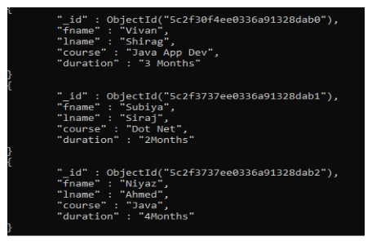
What is MongoDB?
Most popular NoSQL database.
Open-source document-oriented database.
Its scale-out architecture allows you to meet the increasing demand for your system by adding more nodes to share the load.
MongoDB uses BSON (Binary JSON) to query database.
Stores data in the form of BSON documents.

Slide 3
What is NoSQL Database?
The term “NoSQL database” refer to any “Non-relational” or “Not only SQL” databases provides a mechanism for storage and retrieval of data in a format other than tabular relations model used in relational databases.
NoSQL database doesn't use tables for storing data.
It is generally used to store big data and real-time web applications.
Flexible schema i.e., no predefined or rigid schema.

Slide 4
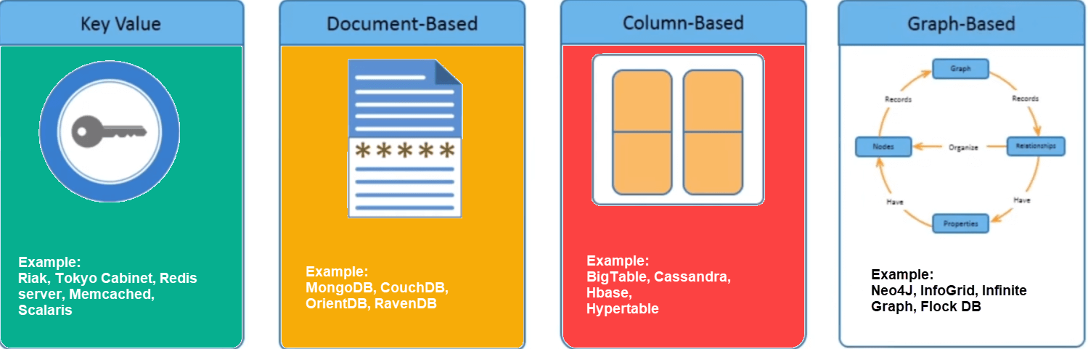
Types of NoSQL Database
NoSQL Databases are mainly categorized into four types: Key-value pair, Column-oriented, Graph-based & Document-oriented.

Slide 5
SQL Vs NoSQL
SQL | NoSQL
SQL databases are primarily called RDBMS or Relational Databases. | NoSQL databases are primarily called as Non-relational or distributed database.
SQL databases are table-based databases. | NoSQL databases can be document based, key-value pairs, graph databases.
Vertical Scalability | Horizontal Scalability
Fixed or Predefined schema. | Flexible schema.
Not suitable for hierarchical data storage. | Suitable for hierarchical data storage.
Oracle, MySQL, Microsoft SQL Server, and PostgreSQL. | Document: MongoDB and CouchDB, Key-value: Redis and DynamoDB, Column-based: Cassandra and HBase, Graph: Neo4j and Amazon Neptune.

Slide 6
When to use NoSQL?
For Big Data – When you need to store and retrieve a huge amount of data quickly.
For Flexible Data – When your data keeps changing and doesn’t fit into a fixed structure.
For High-Speed Performance – When you don’t need complex relationships (JOINs) between data and want faster queries.
For Scalability – When your data is growing continuously, and you need to easily add more servers.
For Real-Time Applications – When working with social media, IoT, gaming, analytics, or any system needing fast, scalable, and flexible storage.

Slide 7
Features of MongoDB
Fast Search (Indexing): Helps find data quickly and process it efficiently.
Scalability: Can handle large data by dividing it across multiple servers (sharding).
High Availability (Replication): Keeps multiple copies of data on different servers, so if one fails, data is still safe.
Automatic Load Balancing: Distributes the workload evenly across servers for smooth performance.
Aggregation: Allows data calculations like sum, average, min, max, similar to GROUP BY in SQL.
Multi-Language Support: Works with Node.js, Python, Java, C++, C#, PHP, Ruby, Scala, Rust, and more.

Slide 8
Advantages of MongoDB
Dynamic Schema Design: Flexible schema eliminates the need for a predefined structure.
Scalability: Supports horizontal scaling through sharding, distributing data across multiple servers.
Real-Time Data Handling: The aggregation framework enables real-time processing, making it ideal for analytics and dashboards.
Ease of Maintenance: No rigid schema makes updates and migrations simpler, reducing downtime.
Support for Complex Data Structures: Stores nested and hierarchical data without joins, simplifying retrieval.

Slide 9
Disadvantages of MongoDB
Limited ACID Transactions: Supports ACID at the document level but lacks full transactional support across multiple documents or collections.
Increased Memory Usage: Stores field names with each document, leading to higher memory consumption.
Lack of Join Support: Does not natively support joins, requiring $lookup, which can be slower and resource-intensive.
Document Size Limit: Imposes a 16 MB document size limit, restricting very large single objects.
Complex Sharding: While enhancing scalability, sharding can be challenging to configure and manage properly.

Slide 10
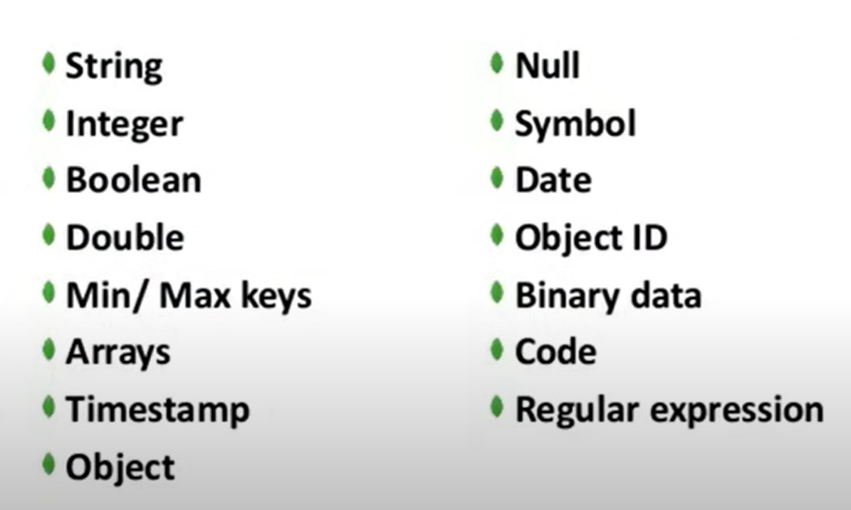
MongoDB Data Types

Slide 11
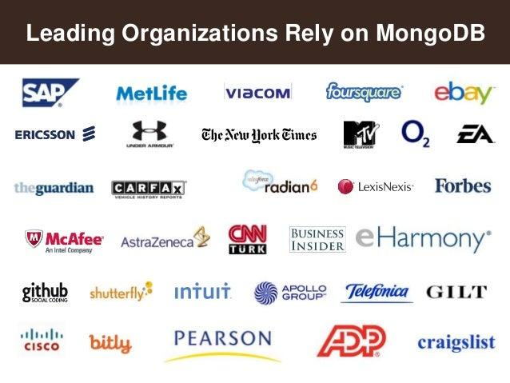
Who’s is using MongoDB?
MongoDB has been adopted as backend software by a few major websites and services including Toyota, Cisco, Shutterfly, Adobe, Ericsson, Craigslist, eBay, and Foursquare.

Slide 12
MongoDB Terms
Databases: A database stores one or more collections of documents.
Collections: MongoDB stores documents in collections. Collections are analogous to tables in relational databases.
Documents: MongoDB stores data records as BSON documents & similar to JSON objects. It is analogous to row in relational databases. These are composed of field-and-value pairs and have the following structure:
{
field1: value1,
field2: value2,
field3: value3,
...
fieldN: valueN
}
Fields Names: These are strings analogous to column in relational databases.

Slide 13
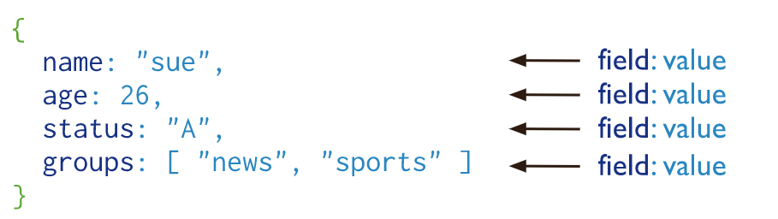
Example

Slide 14
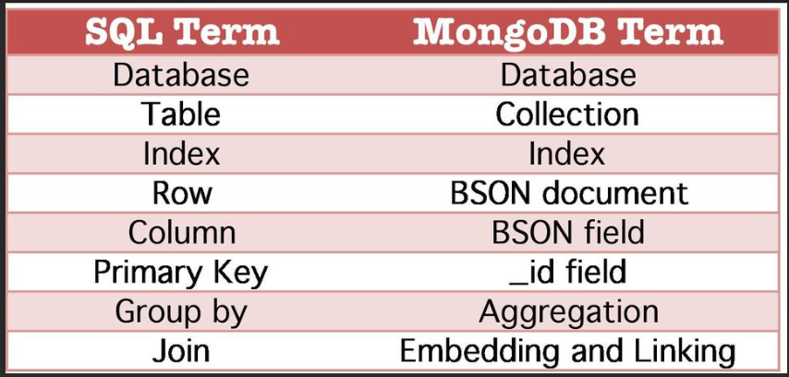
SQL Vs MongoDB Terms

Slide 15
MongoDB Installation
MongoDB is available in two server editions: Community and Enterprise.
Community edition is free & Enterprise edition is a paid version and has some advanced features.
Installation links:
Install MongoDB — MongoDB Manual
Community: Try MongoDB Community Edition | MongoDB
Enterprise: Try MongoDB Enterprise Advanced | MongoDB
Some basic Commands : https://soulhydra101.github.io/MONGODB-BCT/

Slide 16
MongoDB Compass & MongoDB Atlas
MongoDB Compass is a powerful GUI for querying, aggregating, and analyzing your MongoDB data in a visual environment. It is free to use and can be run on macOS, Windows, and Linux.
Installation link: MongoDB Compass Download | MongoDB
MongoDB Atlas is a multi-cloud database service by the same people that build MongoDB. It makes easy to deploy and manage databases on-demand when and where you need them.
Get Started with Atlas — MongoDB Atlas

Slide 17
Thank you

